Slide 1
Sales Data Analysis Insights and Optimization Strategies presented By: Sherif madkor sr. data analyst

Slide 2
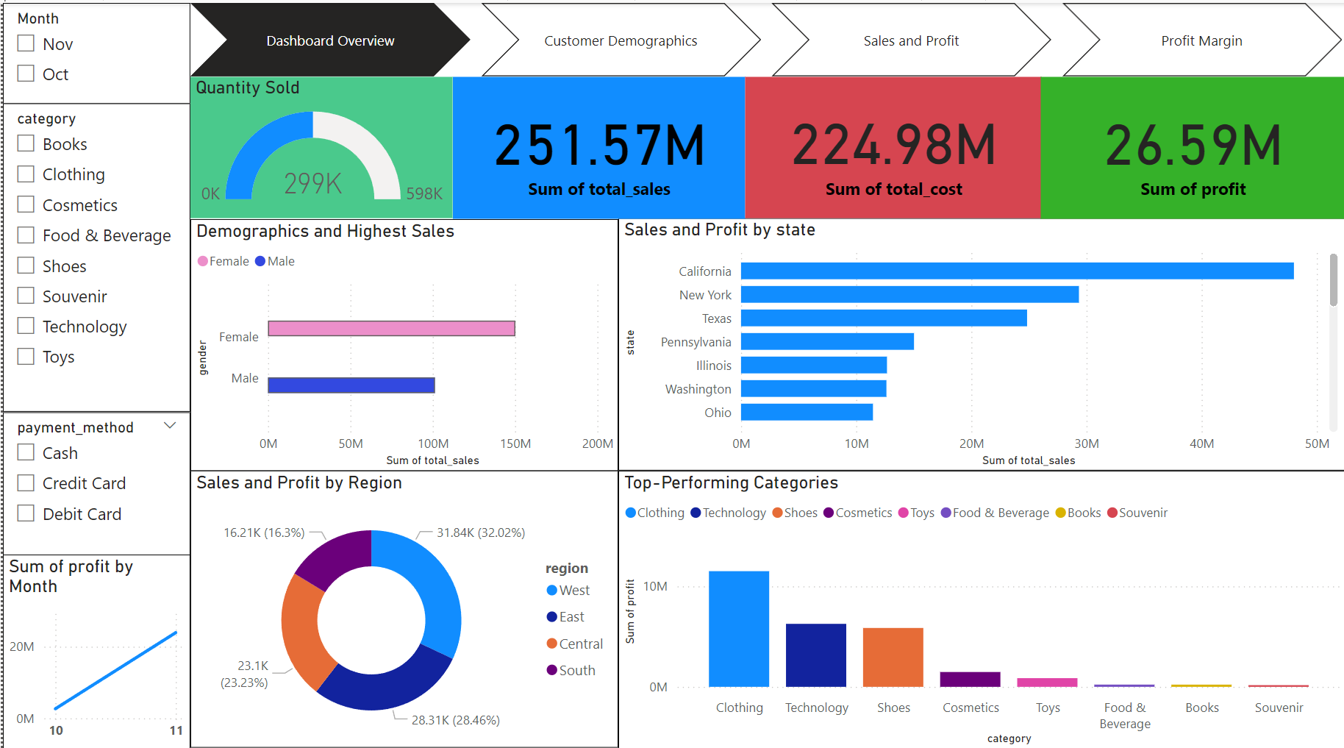

Slide 3
Content
Introduction
Data Overview
Data Cleaning Process
Exploratory Data Analysis (EDA)
Sales and Profit Analysis
Customer Demographics Analysis
Product Category Insights
Visualizations
Conclusions
Recommendations

Slide 4
understanding sales trends, profit margins, and customer behavior.
Data Collection
Data Cleaning
Exploratory Data Analysis EDA
DATA Segmentation
Visualization
Conclusions and Recommendations

Slide 5
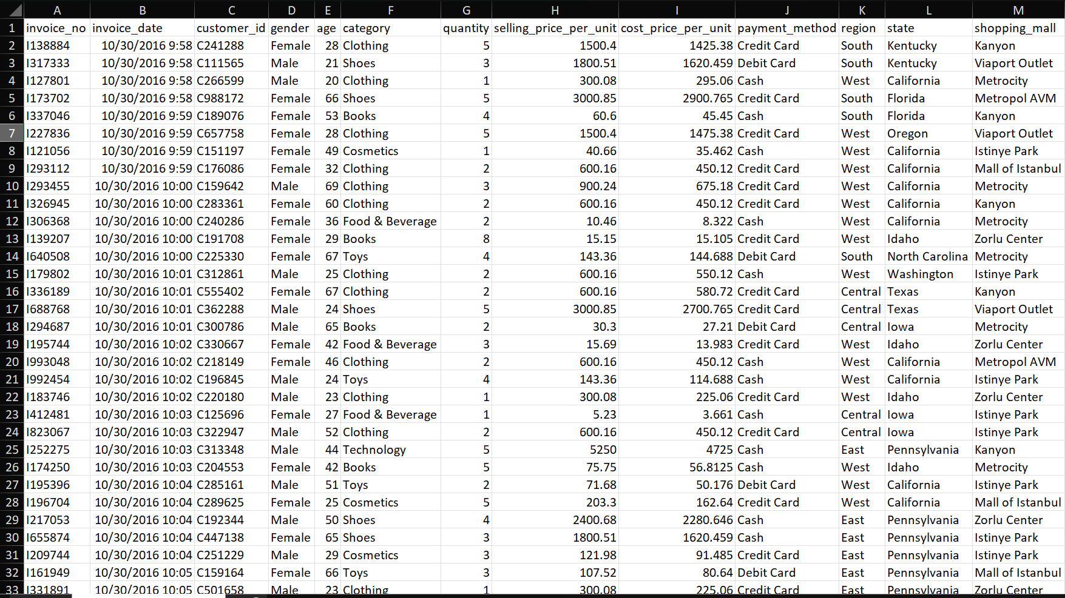
Raw data overview

Slide 6
Data Cleaning
Input: Raw data with potential inconsistencies.
Process:
Removed duplicates.
Split invoice_date and invoice_time.
Ensured consistency in categorical data (e.g., payment methods, categories).
Created new columns (e.g., profit_percentage, month).
Output: Cleaned dataset ready for analysis.

Slide 7
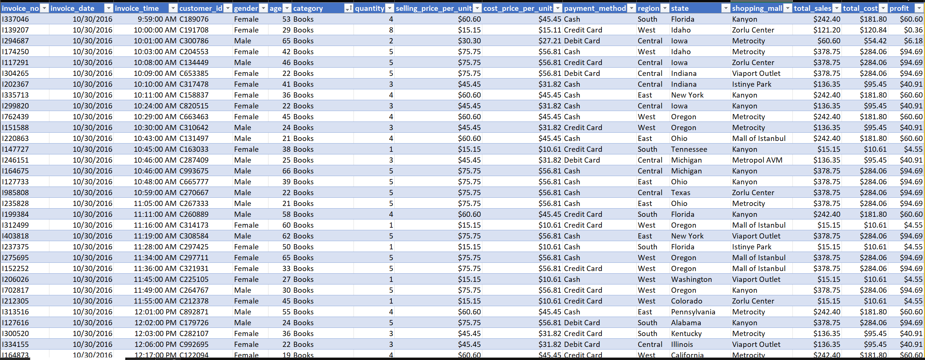
Cleaned dataset

Slide 8
Exploratory Data Analysis (EDA)
Highlight key findings from EDA, such as trends in sales, distribution of profits, and anomalies detected.

Slide 9
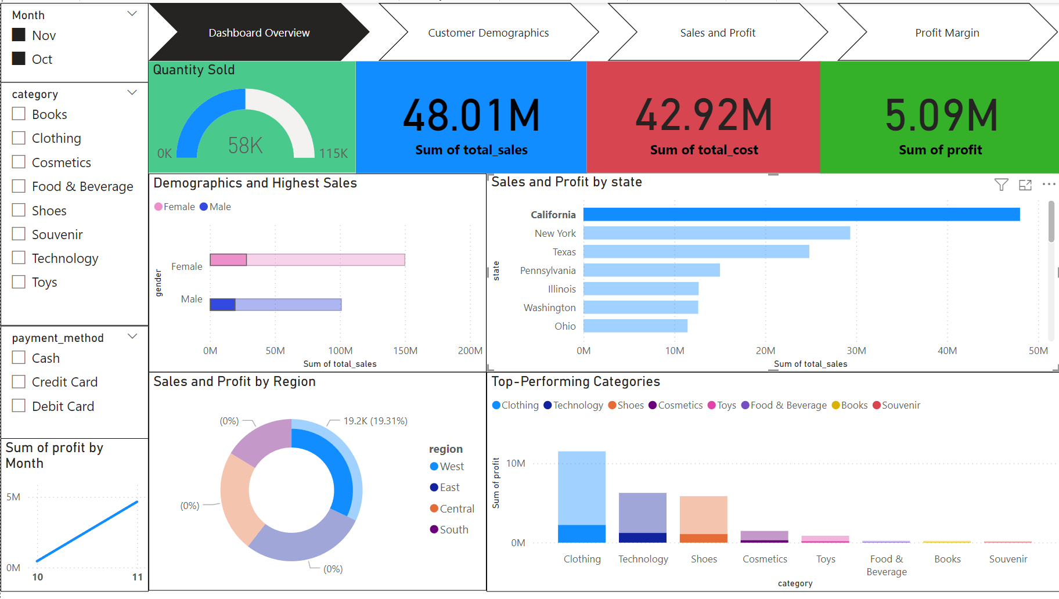
Top selling state California

Slide 10
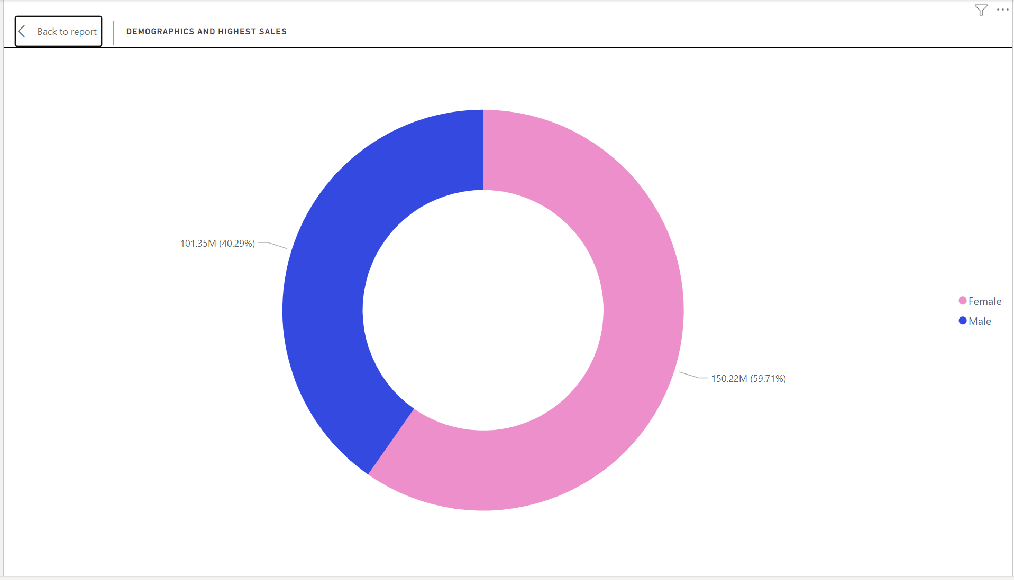
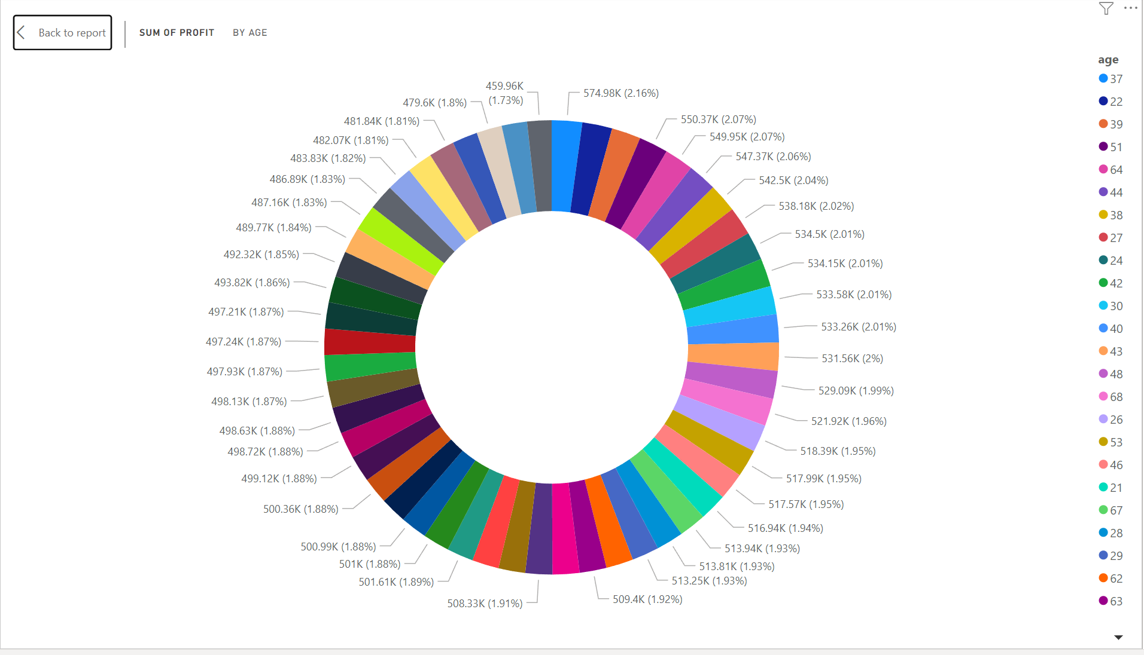
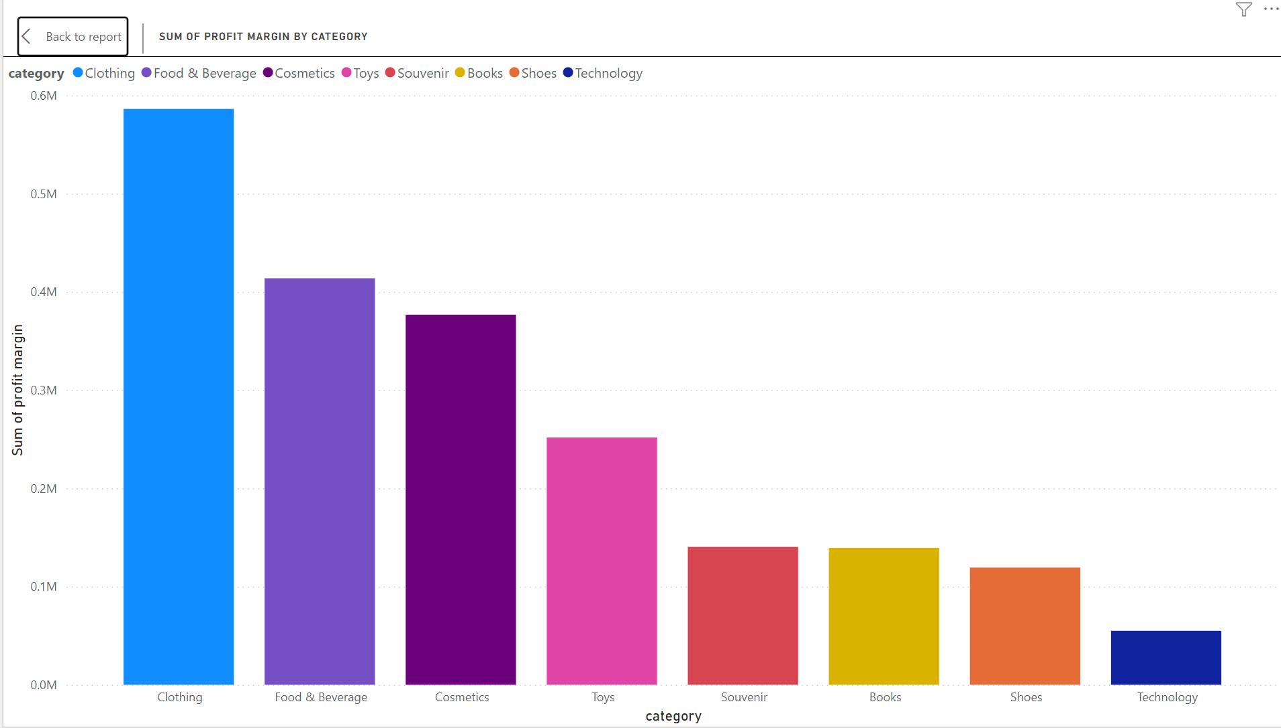
Analysis shows that top sales came from females over males
Average age of buyers
Top selling category was Clothing

Slide 11
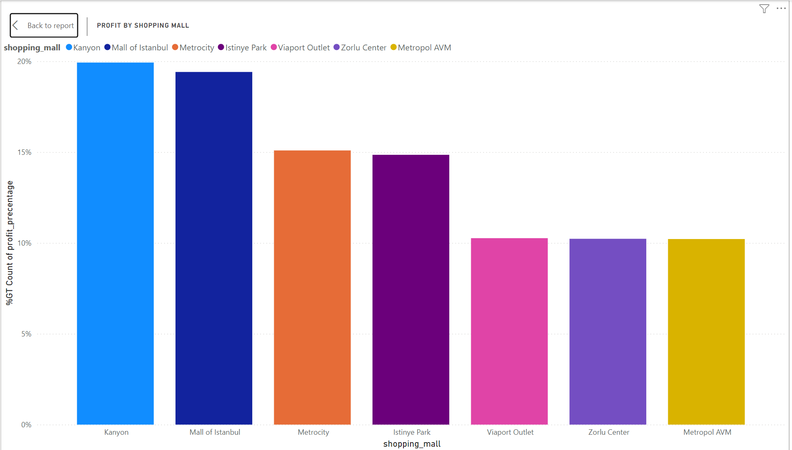
Analysis shows that top selling location was Kanyon mall

Slide 12
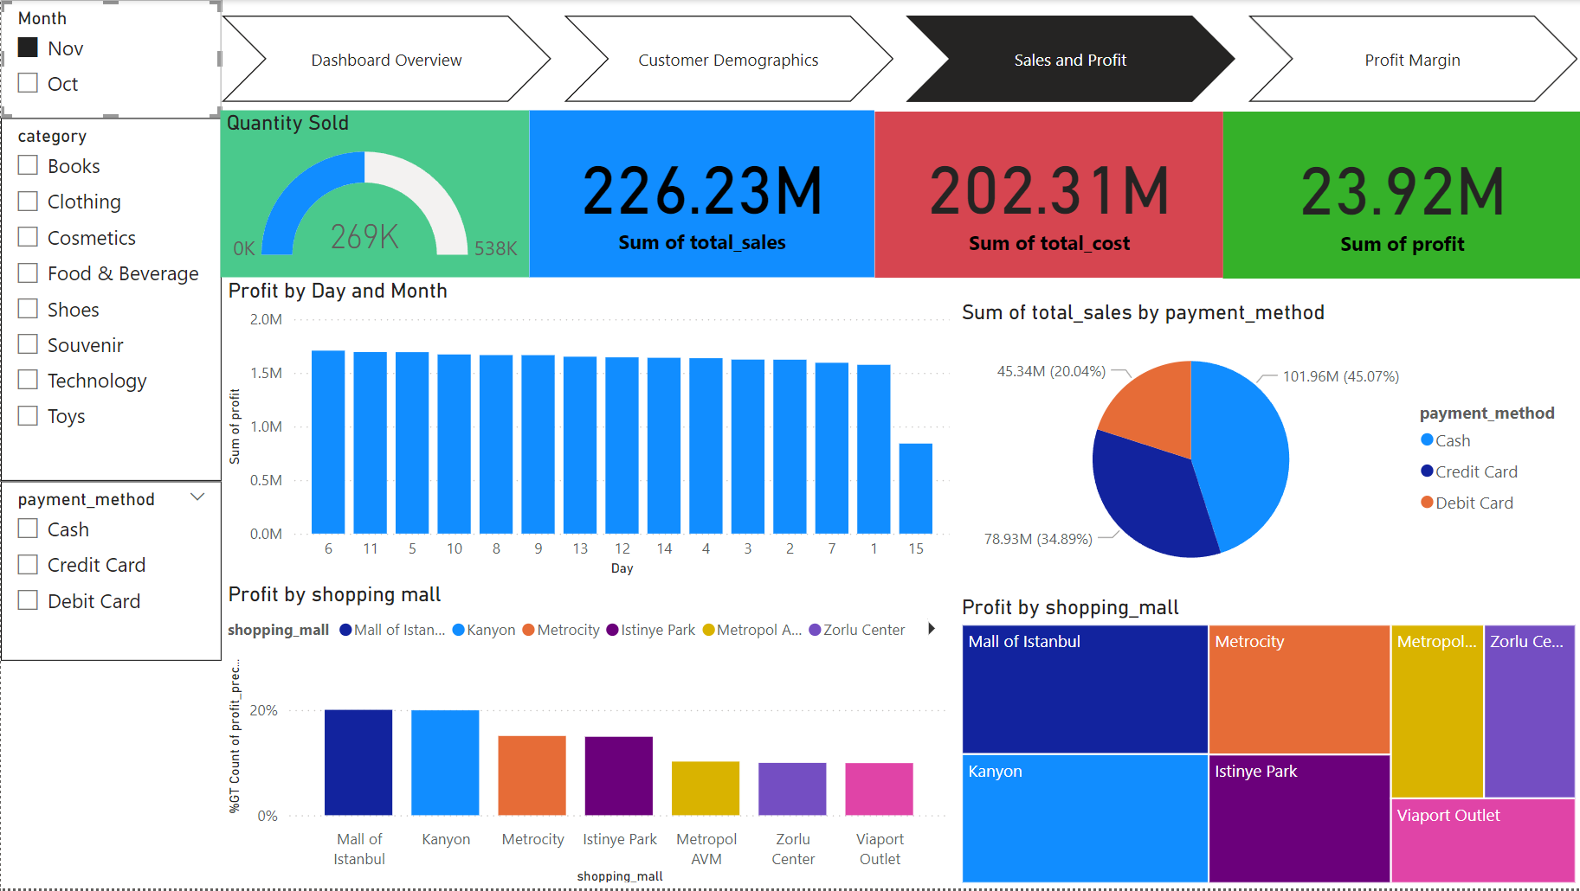
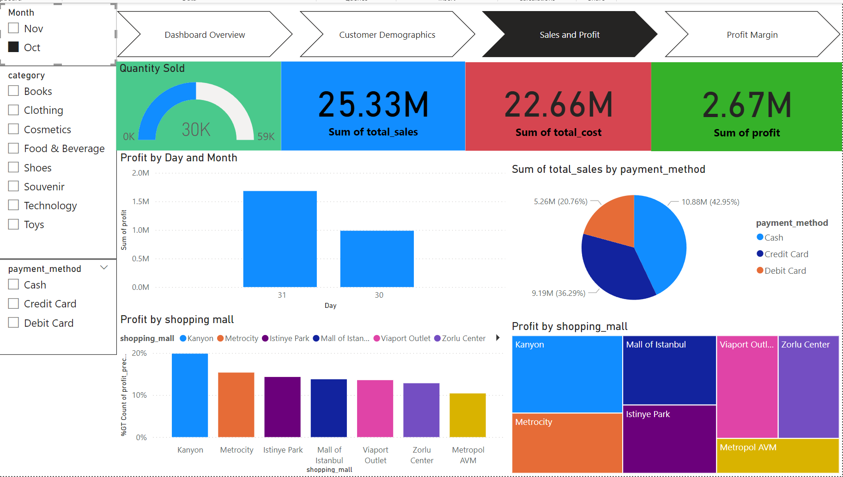
Total Sales By Month
OCTOBER
NOVMBER

Slide 13
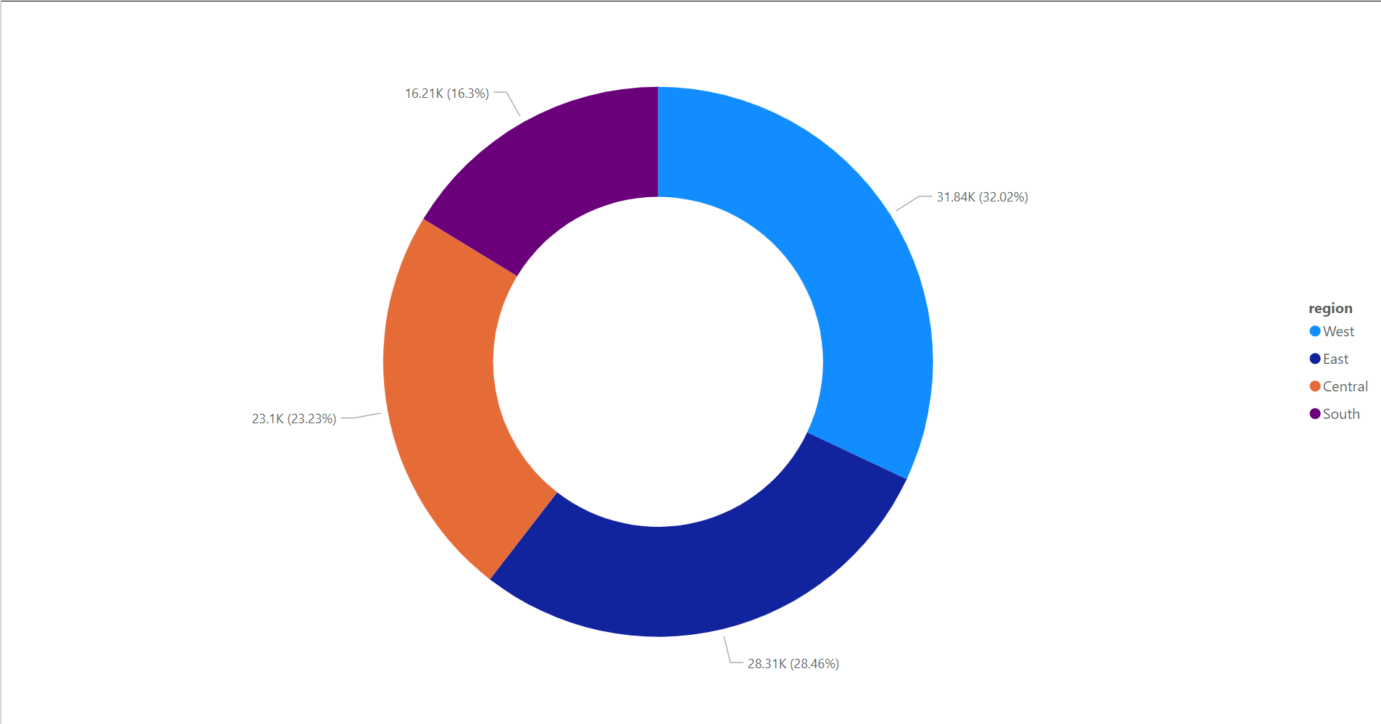
Analysis shows that top sales was in west region with 32.02% of sales and comes in second place east region was 28.46% of sales

Slide 14
Conclusions
High Sales Concentration in Specific States:
The dashboard reveals that California, New York, and Texas are the top three states in terms of total sales, with California leading significantly. These states are major contributors to overall revenue.
Gender-Based Sales Insights:
The gender-based sales distribution indicates that females have a higher purchase volume compared to males. This trend could suggest that marketing strategies targeted towards female consumers might yield better results.
Regional Sales and Profit Distribution:
The West and East regions account for the majority of the sales and profits. The Central and South regions contribute less, indicating potential opportunities for growth in these areas.
Top-Performing Product Categories:
Clothing, Technology, and Shoes are the most profitable product categories. These categories should continue to be a focus for inventory and marketing efforts to maximize profits.
Profit Margin Overview:
The overall profit margin, represented by the total profit of 26.59M, suggests that while sales are strong, there could be areas where cost efficiency can be improved to enhance profitability.

Slide 15
Recommendations:
Focus Marketing Efforts on High-Performing States:
Since California, New York, and Texas are driving significant sales, consider allocating more marketing resources to these states. Additionally, analyze the specific factors contributing to the success in these states and apply similar strategies to other regions.
Enhance Marketing to Female Consumers:
Given that females contribute more to the total sales, marketing campaigns should be tailored to appeal more to female consumers. This could involve targeted advertising, promotions, and product offerings that align with their preferences.
Expand Presence in Underperforming Regions:
The Central and South regions show lower sales and profit figures. Investigate the reasons for underperformance in these areas and explore opportunities for expansion, such as localized marketing campaigns or partnerships with local retailers.
Optimize Inventory for Top-Performing Categories:
Given the high profitability of Clothing, Technology, and Shoes, ensure that these categories are well-stocked and prominently featured in marketing efforts. Consider exploring new subcategories or variations within these top-performing areas to capture more market share.
Improve Cost Management:
While the profit margin is positive, there may be room for improvement in cost management. Conduct a detailed analysis of the cost structure, particularly in the lower-performing regions, and identify areas where expenses can be reduced without compromising sales.
Explore New Markets or Demographics:
Given the concentration of sales in certain regions and demographics, explore potential new markets or customer segments. This could involve expanding into new states, targeting different age groups, or launching new product lines tailored to different customer preferences.

Slide 16
Thank you for your time and attention!
We appreciate your interest in our analysis and findings.
Please feel free to ask any questions or provide feedback.
We look forward to future opportunities to collaborate.
Presented By: Sherif Madkor SR.Data Analyst

